Slide 1
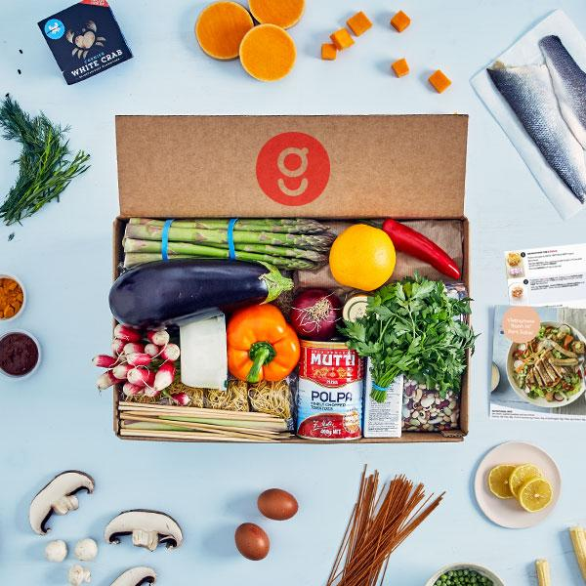
Machine Learning Presentation I:
Recipe Subscription Service
Sanjay Krishna Moorthy
Viswashanthi Bonala
Mitchell Moreno
Sneha Dudyala
Susmitha Haripriya Varanasi

Slide 2
Presentation Outline
Business Scenario
What is our business / What is the problem we are trying to solve?
Data Explanation
Gathering & Formatting Data
Variables Description
Data Visualization / Exploration
Machine Learning Solution
Q & A

Slide 3

Business Scenario
Recipe Subscription Service: Ex. Blue Apron, Hello Fresh
Weekly delivery of ingredients that are ordered by customers
How can we improve our subscriber retention rate? (ie. keep subscribers from leaving)
To increase profits we need to keep our subscribers
We can use Machine Learning! (More on this later)

Slide 4
Data Explanation
1.Source of Data and Context
We have two data sets which are collected from Kaggle (Food.com - Recipes and Reviews)
Recipes Dataset
From the data obtained online there are 522,517 recipes. The data set gives multiple descriptive variables about each type of recipe, i.e ingredients, health related variables, etc
Reviews Dataset
There is about 1.4 Million reviews left by a total of 271,907 different users. The data set has info on rating, author, review text, etc.

Slide 5
Format and Data Description
These datasets are in two different formats:
We will be using CSV formatted files because it is easier to work with in python.
From reviews dataset we have reviews and ratings that come from different authors for different recipes
From recipes dataset we can get detail recipes description and time taken to prepare food.
We will be using a joined dataframe of the recipes and reviews file for our data analysis.

Slide 6
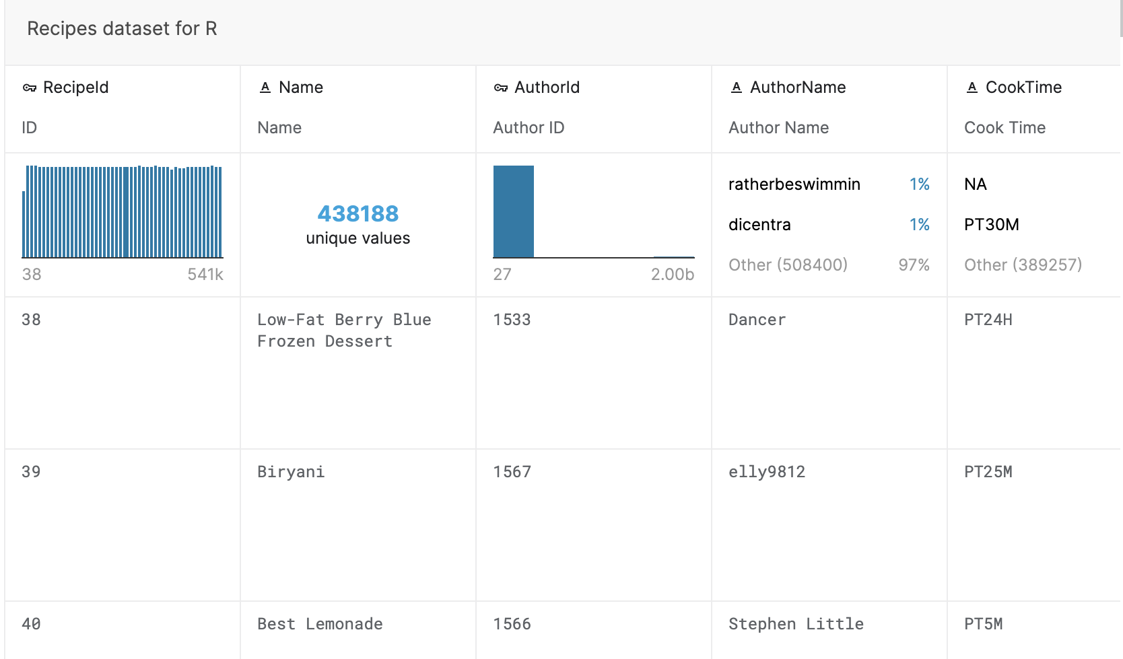
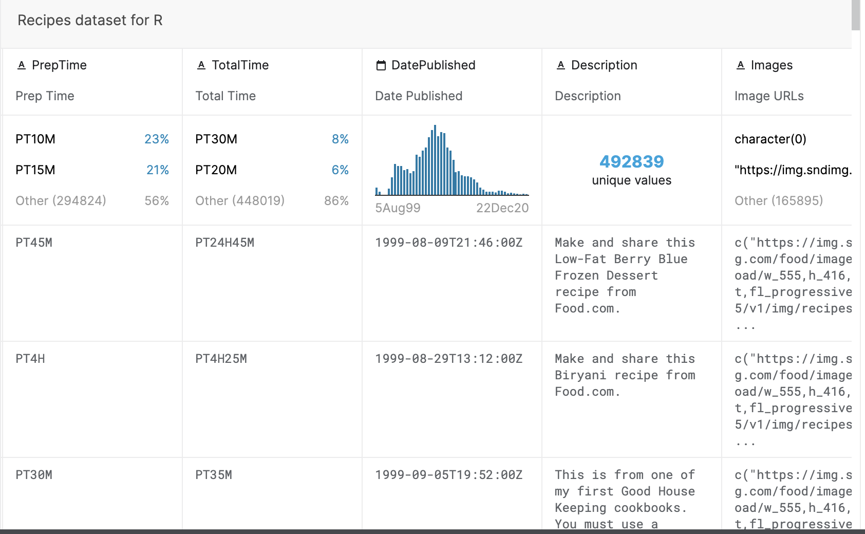
Variable Description

Slide 7
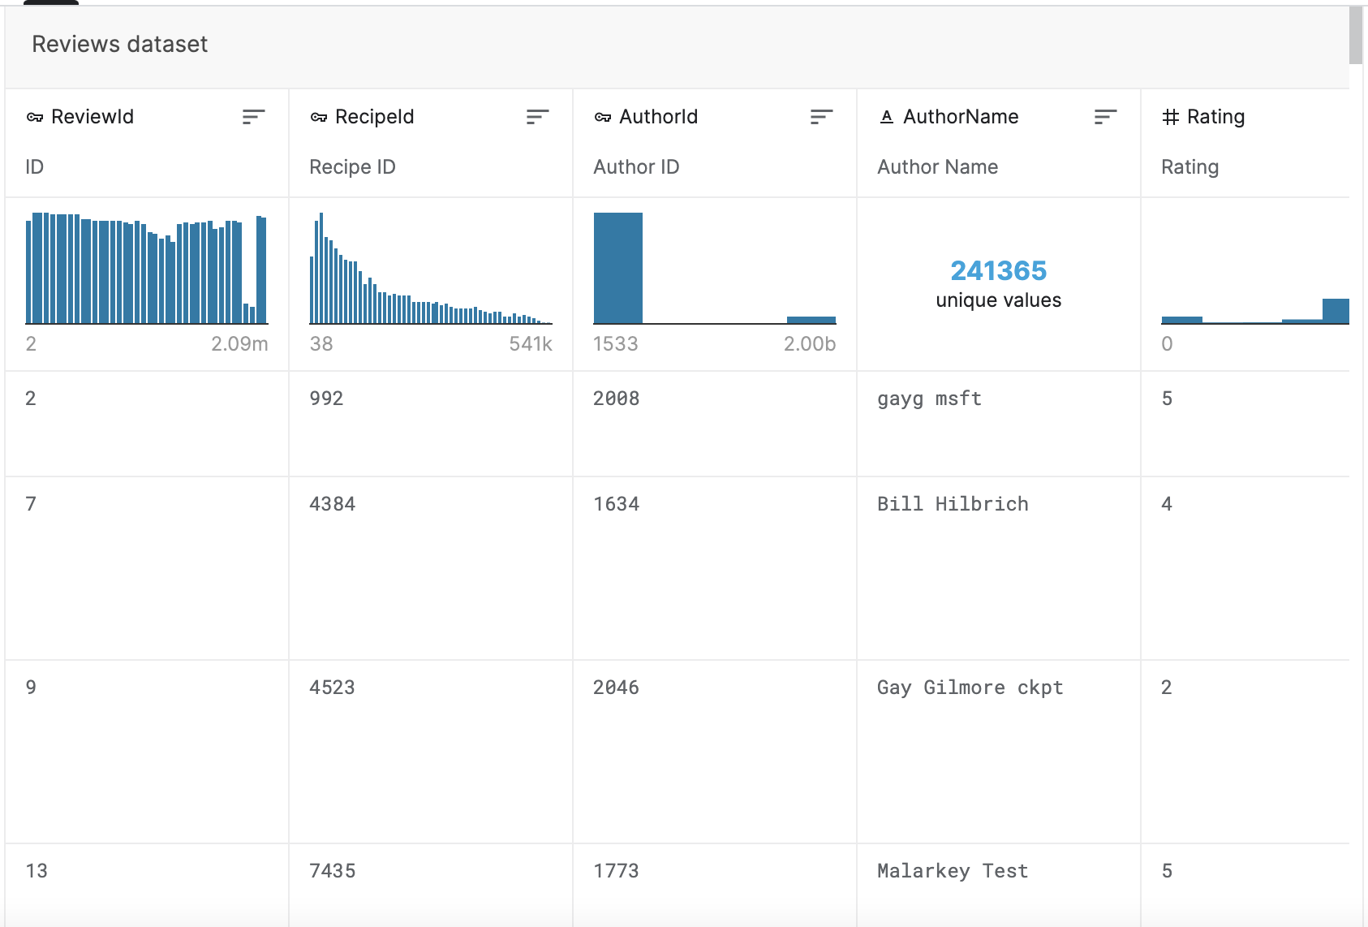
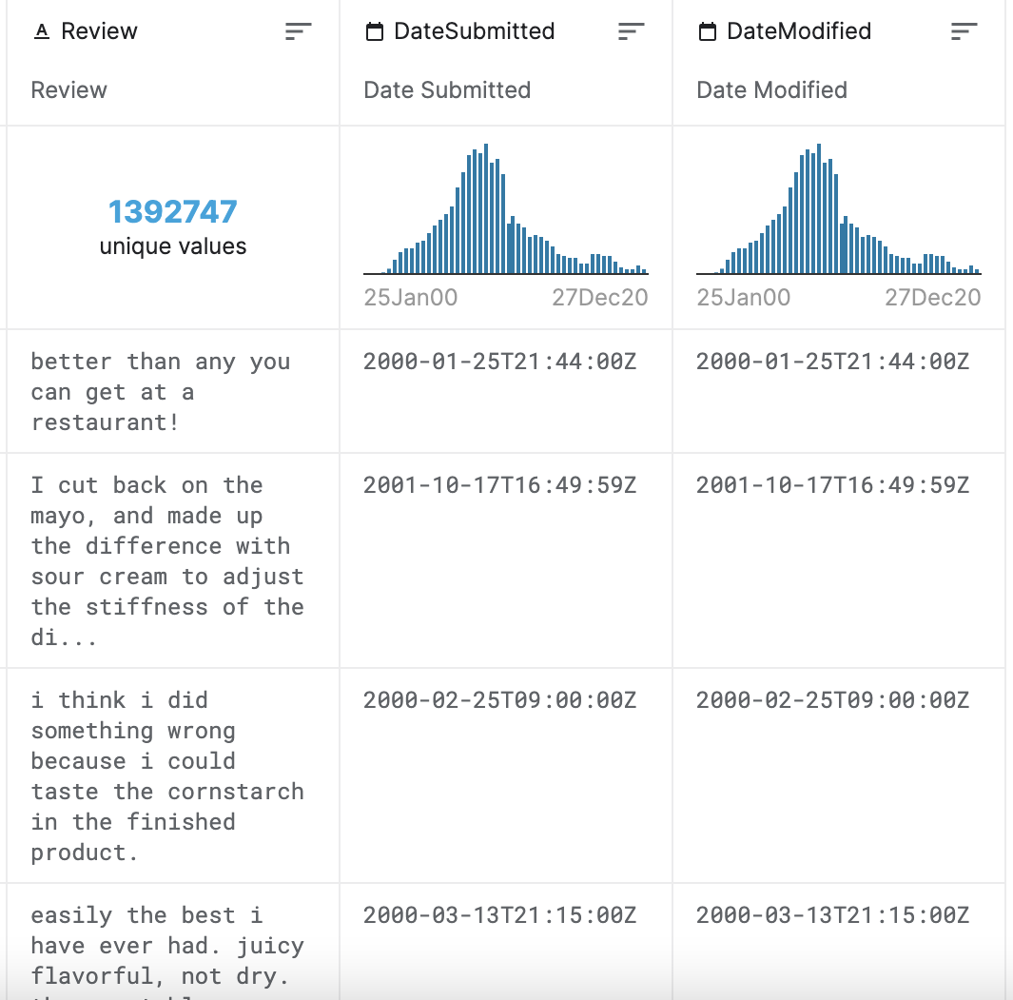
Variable Description

Slide 8
Visualization / Exploration of Data

Slide 9
Visualization / Exploration of Data
In our combined dataframe, there are:
798,270 reviews
157,500 reviewers
229,665 recipes
9853 ingredients used
285 recipe categories

Slide 10
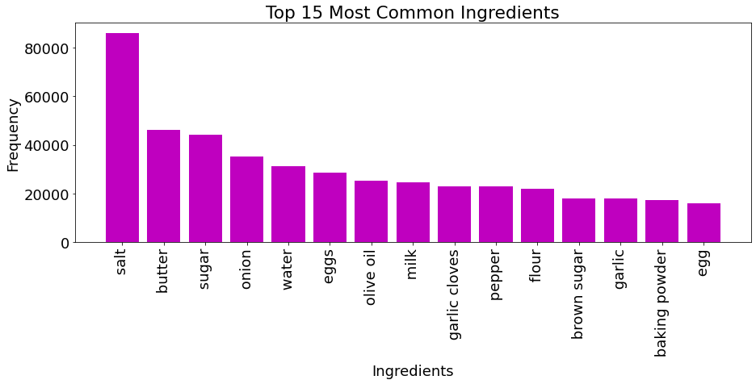

Slide 11

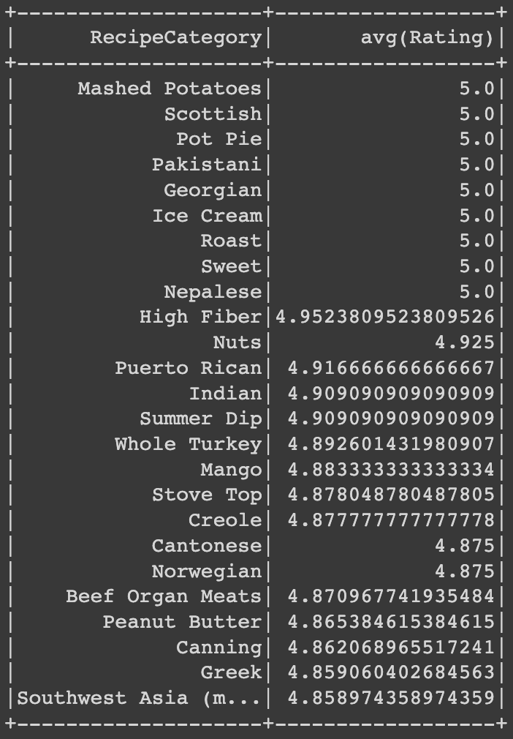
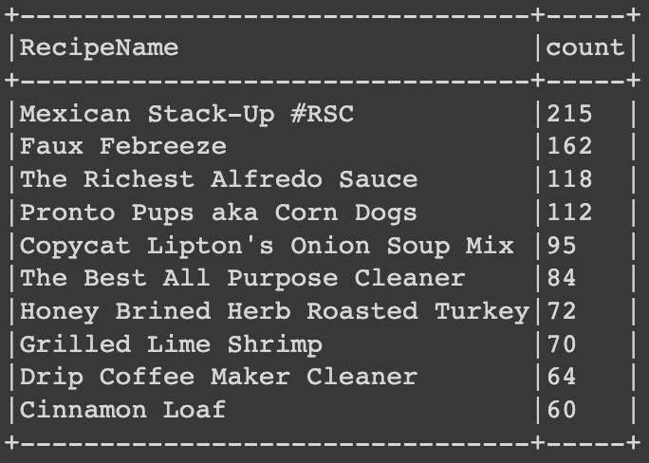

Slide 12
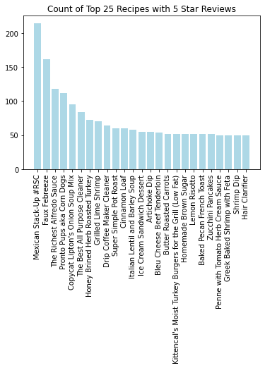

Slide 13
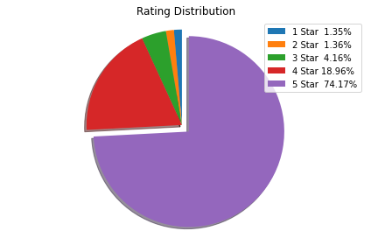
Pie Chart Produced using MatPlotLib

Slide 14
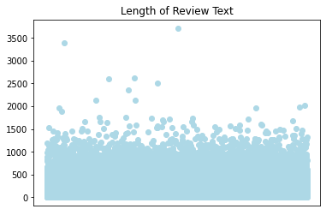

Slide 15
Recommendation Model

Slide 16
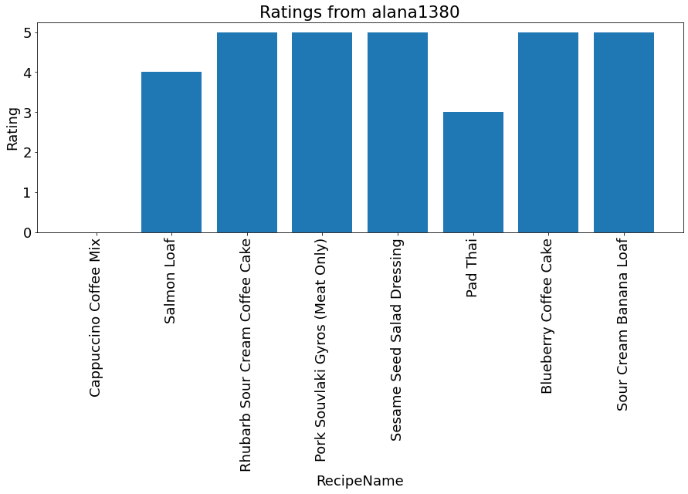

Slide 17
Machine Learning Model
We are using Alternating Least Square (ALS) recommender to solve our problem of customer retention.
We plan to use implicit/explicit recommendations
When a user inputs his/her favourite recipes or provides rating, the ALS algorithm outputs top N food recommendations for that user based on the ranking of the rating predictions.

Slide 18
Q&A

Slide 19
References
https://www.kaggle.com/datasets/irkaal/foodcom-recipes-and-reviews
Reviews Data File:
https://drive.google.com/file/d/1F0-ASQ7DJagtpugLqvQhDPggbQkwwjRm/view?usp=sharing
Recipes Data File:
https://drive.google.com/file/d/1-1VAw_qINDSeV_PBD-ylF0DnkDwL_wGt/view?usp=sharing

